Slide 1

Cub Scouts’ Athletics Challenge

Slide 2
Warm up

Slide 3

Challenge 1 - The Best Outfit
Find the best outfit you have in your home for exercising.
We’ll then take it in turns to explain why our outfit is the best for exercise.
You have 2 minutes to find your outfit!

Slide 4
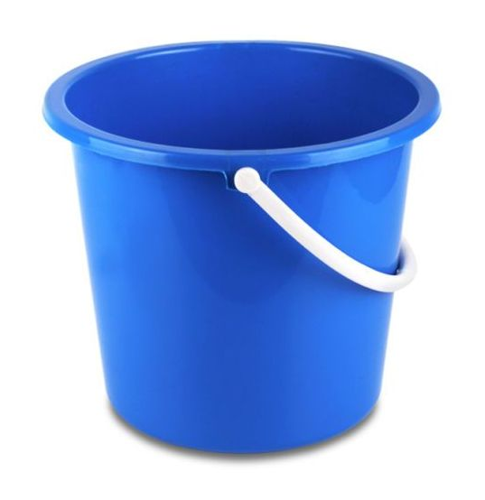
Challenge 2 - The Best Thrower
For this challenge you will need a bucket / bowl / box and 3 soft items you can throw.
Start by standing 3 steps away from the bucket. All together we will throw our 3 items into the bucket.
If you miss all 3 shots, you are out.
Once everyone has thrown, we will all take another step back.
The last person still in wins!

Slide 5
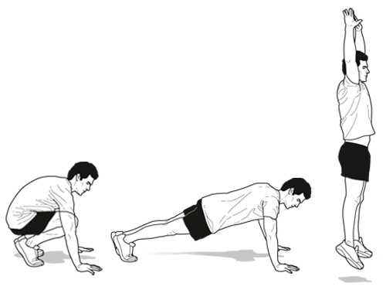
Challenge 3 - Burpees
Watch the demonstration.
How many can you do in one minute?
The clock starts now!

Slide 6
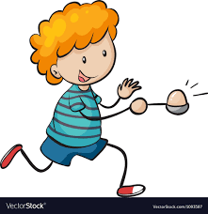
Challenge 4 - Egg And Spoon Race
For this challenge you will need a spoon and a small ball-shaped object to use as your ‘egg.
You need to do an entire loop of your home without dropping the egg.
If you drop the egg you have to start again!
Come back to your screen when you have finished…

Slide 7
Challenge 5 - QUIZ
For this challenge you will need a pen and pencil.
Each question will be multiple choice - write down your answer for each question. There will be 10 questions.
We will go through the answers at the end.

Slide 8
QUESTION 1
How much sleep should you (as an 8-10 year old) have each night to stay healthy?
7 hours
8 hours
9 hours
10 hours

Slide 9
QUESTION 2
Vitamin A is found in fruit and vegetables such as carrots, peppers, spinach and oranges. Why is it important to get enough Vitamin A?
To keep your bones strong
To help your muscles grow
To help your vision when it’s dim
To keep your nails strong

Slide 10
QUESTION 3
Eliud Kipchoge became the first athlete to run a sub 2 hour marathon last year, coming in at 1 hour 59 minutes and 40 seconds. How fast did he run on average to achieve this?
5.3 mph
13.2 mph
26.2 mph
34.9 mph

Slide 11
QUESTION 4
What does a ‘birdie’ mean if you are playing golf?
You’ve scored 1 under par.
You’ve lost the ball in a tree.
You’ve got a whole in one.
You’ve hit the ball really high.

Slide 12
QUESTION 5
What colour is the centre of the target in Archery?
Blue
Red
Black
Yellow

Slide 13
QUESTION 6
Which of these has never been an olympic sport?
Swimming obstacle course
Tug of war
Unicycling
Rope Climbing

Slide 14
QUESTION 7
The score is currently deuce. What sport am I playing?
Basketball
Darts
Fencing
Tennis

Slide 15
QUESTION 8
Which of these food does NOT count towards your 5 a day?
kale
parsnips
potatoes
orange juice

Slide 16
QUESTION 9
What muscles are found in your stomach and are commonly referred to as ‘abs’?
Pectorals
Quadriceps
Deltoids
Rectus Abdominis

Slide 17
QUESTION 10
In what sport can you win the Yellow Jersey?
Cycling
Running
Skiing
Martial Arts

Slide 18
ANSWERS

Slide 19
QUESTION 1
How much sleep should you (as an 8-10 year old) have each night to stay healthy?
7 hours
8 hours
9 hours
10 hours

Slide 20
QUESTION 2
Vitamin A is found in fruit and vegetables such as carrots, peppers, spinach and oranges. Why is it important to get enough Vitamin A?
To keep your bones strong
To help your muscles grow
To help your vision when it’s dim
To keep your nails strong

Slide 21
QUESTION 3
Eliud Kipchoge became the first athlete to run a sub 2 hour marathon last year, coming in at 1 hour 59 minutes and 40 seconds. How fast did he run on average to achieve this?
5.3 mph
13.2 mph
26.2 mph
34.9 mph

Slide 22
QUESTION 4
What does a ‘birdie’ mean if you are playing golf?
You’ve scored 1 under par.
You’ve lost the ball in a tree.
You’ve got a whole in one.
You’ve hit the ball really high.

Slide 23
QUESTION 5
What colour is the centre of the target in Archery?
Blue
Red
Black
Yellow

Slide 24
QUESTION 6
Which of these has never been an olympic sport?
Swimming obstacle course
Tug of war
Unicycling
Rope Climbing

Slide 25
QUESTION 7
The score is currently deuce. What sport am I playing?
Basketball
Darts
Fencing
Tennis

Slide 26
QUESTION 8
Which of these food does NOT count towards your 5 a day?
kale
parsnips
potatoes
orange juice

Slide 27
QUESTION 9
What muscles are found in your stomach and are commonly referred to as ‘abs’?
Pectorals
Quadriceps
Deltoids
Rectus Abdominis

Slide 28
QUESTION 10
In what sport can you win the Yellow Jersey?
Cycling
Running
Skiing
Martial Arts

Slide 29
How many did you get right?

Slide 30
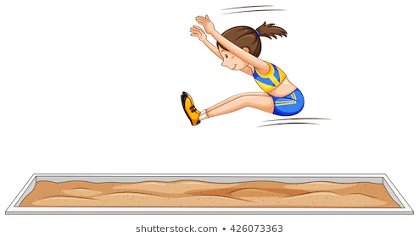
Challenge 6 - JUMP
For this challenge you will need a tape measure.
Watch the demonstration first.
You need to jump as far as you can and ask an adult to help you measure the distance!

Slide 31
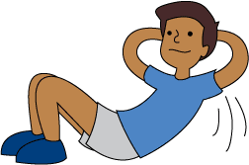
Challenge 7 – Sit Ups
For this challenge you will need to do as many sit ups as you can in 1 minute.
Watch the demonstration first!

Slide 32
Cool Down

Slide 33
Congratulations!
You’ve just earned your Cub Scout Athletics activity badge

